Slide 1
Advanced Programming
K.N.Toosi
Spring 2023

Slide 2
Syllabus
Object Oriented Programming
Inheritance, Polymorphism, Encapsulation and Abstraction
GUI Programming
Tkinter, Turtle
Exception handling
Leftovers
Functional programming, Comprehension, generators

Slide 3
Grading & Resources
Final 40%
HW 30%
Project 30%
UML @ Classroom: An Introduction to Object-Oriented Modeling, 2015, Martina Seidl
Python 3 Object-oriented Programming, 2015, Dusty Phillips
Python GUI Programming with Tkinter: Design and build functional and user-friendly GUI applications, 2021, Alan D. Moore
TAs: Arash Zarin nia
Sina Rahimzadeh

Slide 4
Introducing object-oriented
In real-world: what an object is?—a tangible thing that we can sense, feel, and manipulate. certain objects do certain things.
In software development: Software objects are not typically tangible things that you can pick up, sense, or feel, but they are models of something that can do certain things and have certain things done to them.
Formally, an object is a collection of data and associated behaviors.
what does it mean to be object-oriented?
one of the many techniques used for modeling complex systems by describing a collection of interacting objects via their data and behavior.

Slide 5
Stages of object-oriented software development
Object-oriented analysis (OOA)
the process of looking at a problem and identifying the objects and interactions between those objects. The analysis stage is all about what needs to be done. A better turn of phrase might be object-oriented exploration.
Object-oriented design (OOD)
the process of converting such requirements into an implementation specification. The designer must name the objects, define the behaviors, and formally specify which objects can activate specific behaviors on other objects. The design stage is all about how things should be done.
Object-oriented programming (OOP)
the process of converting this perfectly defined design into a working program that does exactly what the customer originally requested.

Slide 6
Objects and classes
How do we differentiate between types of objects?
Imagine an inventory application for a fruit farm. Assume in this application that apples go in barrels and oranges go in baskets.
we have four kinds of objects: apples, oranges, baskets, and barrels. In object-oriented modeling, the term used for kind of object is class.
Classes describe objects.
You might have three oranges sitting on the table in front of you. Each orange is a distinct object, but all three have the attributes and behaviors associated with one class: the general class of oranges.
Objects are instances of classes that can be associated with each other.
An object instance is a specific object with its own set of data and behaviors; a specific orange on the table in front of us is said to be an instance of the general class of oranges.

Slide 7
UML (Unified Modeling Language) class diagram
The Unified Modeling Language (UML) is a general-purpose, developmental modeling language in the field of software engineering that is intended to provide a standard way to visualize the design of a system.
The class diagram is without doubt the most widely used UML diagram.
In the context of object-oriented programming, the class diagram visualizes the classes a software system consists of and the relationships between these classes.

Slide 8
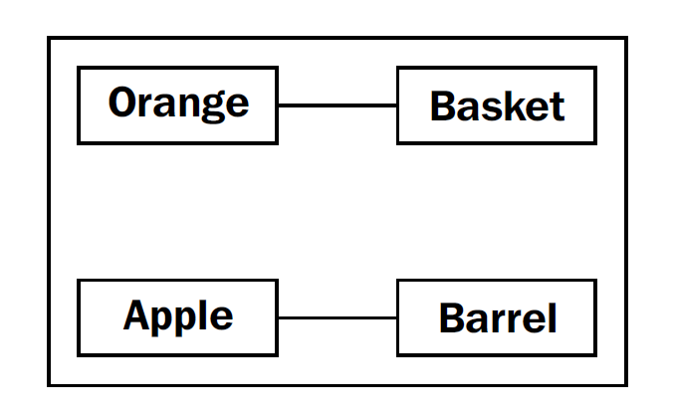
Example of class diagram
This diagram shows that an Orange is somehow associated with a Basket and that an Apple is also somehow associated with a Barrel. Association is the most basic way for two classes to be related.

Slide 9
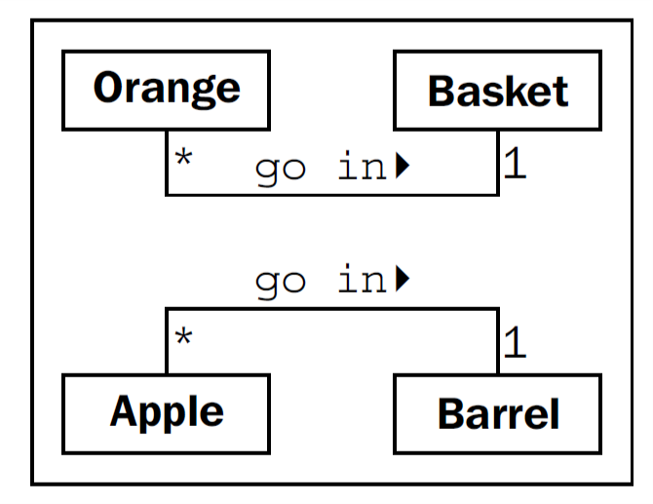
Example of class diagram
In the case of apples and barrels, we can be fairly confident that the association is, many apples go in one barrel .
This number is referred to as the multiplicity of the object.
For the apple goes in barrel association, reading from left to right, many Apple objects can go in any one Barrel. Reading from right to left, exactly one Barrel can be associated with any one Apple.

Slide 10
Specifying attributes and behaviors
Objects are instances of classes that can be associated with each other.
An object instance is a specific object with its own set of data and behaviors.
Object
Data describes objects
Behaviors are actions

Slide 11
Data & Attributes
Data represents the individual characteristics of a certain object.
A class can define specific sets of characteristics that are shared by all objects of that class.
Any specific object can have different data values for the given characteristics.
For example, our three oranges on the table could each weigh a different amount.
The orange class could have a weight attribute.
All instances of the orange class have a weight attribute, but each orange has a different value for this attribute.
Attributes don't have to be unique.
As a more realistic example, two objects representing different customers might have the same value for a first name attribute.

Slide 12
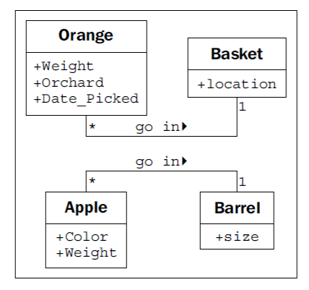
Lets Update the class diagram!

Slide 13
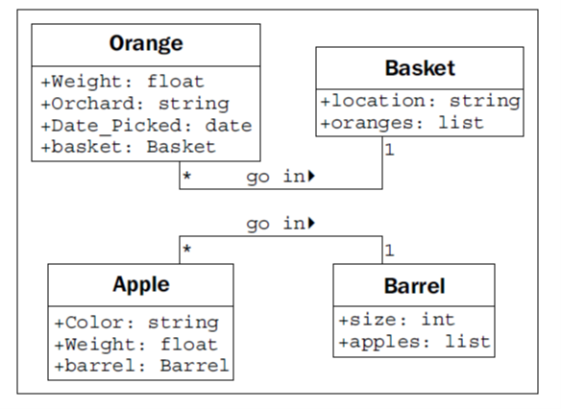
Adding the type for each attribute
Attribute types are often primitives that are standard to most programming languages, such as integer, floating-point number, string, byte, or Boolean. However, they can also represent data structures such as lists, trees, or graphs, or most notably, other classes.

Slide 14
Behaviors & methods
Behaviors are actions that can occur on an object. The behaviors that can be performed on a specific class of objects are called methods.
At the programming level, methods are like functions in structured programming, but they magically have access to all the data associated with this object. Like functions, methods can also accept parameters and return values.
Let’s go back to our fruit farm example:
One action that can be associated with oranges is the pick action. Pick would place the orange in a basket by updating the basket attribute of the orange, and by adding the orange to the oranges list on the Basket.
So, pick needs to know what basket it is dealing with. We do this by giving the pick method a basket parameter.
We can add a squeeze method to Orange. When squeezed, squeeze might return the amount of juice retrieved, while also removing the Orange from the basket it was in.
Basket can have a sell action. When a basket is sold, our inventory system might update some data on as-yet unspecified objects for accounting and profit calculations. Alternatively, our basket of oranges might go bad before we can sell them, so we add a discard method.

Slide 15
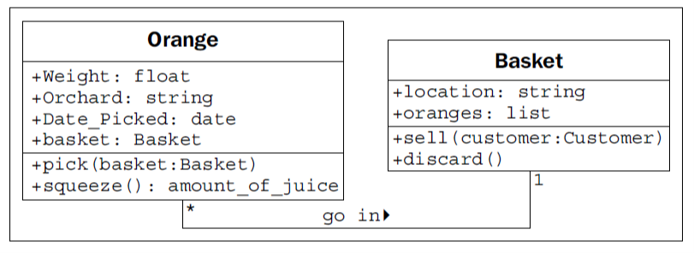
Let's add these methods to our diagram

Slide 16
Creating Python classes
Define class
class MyFirstClass:
pass
Instantiate objects of that class
a = MyFirstClass()
b = MyFirstClass()
It looks much like a normal function call, but Python knows we're "calling" a class and not a function, so it understands that its job is to create a new object.

Slide 17
Adding attributes
class Point:
pass
p1 = Point()
p2 = Point()
p1.x = 5
p1.y = 4
p2.x = 3
p2.y = 6
This code creates an empty Point class with no data or behaviors.
Then it creates two instances of that class and assigns each of those instances x and y coordinates to identify a point in two dimensions
dot notation :To assign a value to an attribute on an object use the <object>.<attribute> = <value> syntax.
The value can be anything: a built-in data type, or another object.

Slide 18
Adding behaviors
Let's model a couple of actions on our Point class. We can start with a called reset that moves the point to the origin (the origin is the point where x and y are both zero).
class Point:
def reset(self):
self.x = 0
self.y = 0
p = Point()
p.reset()
print(p.x, p.y)

Slide 19
The important “Self” parameter
The one difference between methods and normal functions is that all methods have one required argument. This argument is conventionally named self.
The self argument to a method is simply a reference to the object that the method is being invoked on. We can access attributes and methods of that object as if it were any another object.
When we call the p.reset()method, we do not have to pass the self argument into it.
Python automatically takes care of this for us. It knows we're calling a method on the p object, so it automatically passes that object to the method.

Slide 20
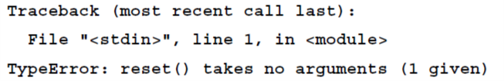
The important “Self” parameter
Instead of calling the method on the object, we can invoke the function on the class, explicitly passing our object as the self argument:
p = Point()
Point.reset(p)
print(p.x, p.y)
What happens if we forget to include the self argument in our class definition?
class Point:
def reset():
pass
p = Point()
p.reset()

Slide 21
More arguments
import math
class Point:
def move(self, x, y):
self.x = x
self.y = y
def reset(self):
self.move(0, 0)
def calculate_distance(self, other_point):
return math.sqrt(
(self.x - other_point.x)**2 +
(self.y - other_point.y)**2)
Let's add a new method that allows us to move a point to an arbitrary position, not just to the origin.
We can also include one that accepts another Point object as input and returns the distance between them.

Slide 22
How to use?
point1 = Point()
point2 = Point()
point1.reset()
point2.move(5,0)
print(point2.calculate_distance(point1))
assert (point2.calculate_distance(point1) ==
point1.calculate_distance(point2))
point1.move(3,4)
print(point1.calculate_distance(point2))
print(point1.calculate_distance(point1))

Slide 23
Initializing the object
If we don't explicitly set the x and y positions on our Point object, either using move or by accessing them directly, we have a broken point with no real position. What will happen when we try to access it?
point = Point()
point.x = 5
print(point.x)
print(point.y)
It would be nice if we could force the user to tell us what those positions should be when they create the object.

Slide 24
The concept of a constructor
Constructor: a special method that creates and initializes the object when it is created
The Python initialization method is the same as any other method, except it has a special name, __init__
class Point:
def __init__(self, x, y):
self.move(x, y)
def move(self, x, y):
self.x = x
self.y = y
def reset(self):
self.move(0, 0)
# Constructing a Point
point = Point(3, 5)
print(point.x, point.y)

Slide 25
What if we don't want to make those two arguments required?
Use keyword argument syntax!
If the calling object does not provide this argument, then the default argument is used instead.
class Point:
def __init__(self, x=0, y=0):
self.move(x, y)

Slide 26
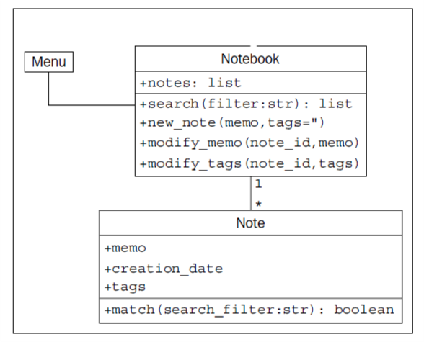
Case Study
“Notes are short memos stored in a notebook. Each note should record the day it was written and can have tags added for easy querying. It should be possible to modify notes. We also need to be able to search for notes. All of these things should be done from the command line. “
For solution, see Jupyter Notebook “Session 3”

Slide 27
So far, we learned to design systems as a group of interacting objects.
Object-oriented analysis and design is all about figuring out what objects are and how they should interact. Now we will focus on describing principles that can be used to make those interactions as simple and intuitive as possible.
Most design patterns rely on two basic object-oriented principles known as composition and inheritance.
Composition is the act of collecting several objects together to create a new one. It models “has-a” relationship. Basic example: A car is composed of an engine, transmission, starter, headlights, and windshield, among numerous other parts
Inheritance is the most famous, well-known, and over-used relationship in object-oriented programming. Inheritance is sort of like a family tree. In object-oriented programming, instead of inheriting features and behaviors from a person, one class can inherit attributes and methods from another class. The “is-a” relationship is formed by inheritance.

Slide 28
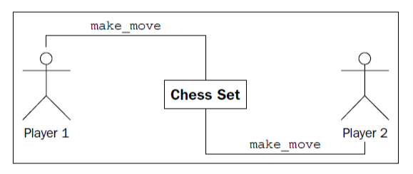
Example: design of a computerized chess game
The game of chess is played between two players, using a chess set featuring a board containing sixty-four positions in an 8 X 8 grid. The board can have two sets of sixteen pieces that can be moved, in alternating turns by the two players in different ways. Each piece can take other pieces. The board will be required to draw itself on the computer screen after each turn.

Slide 29
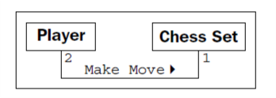
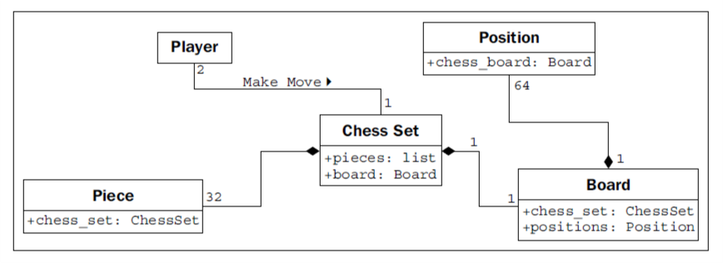
Exactly two players can interact with one chess set. Any player can be playing with only one chess set at a time.
what the Chess Set is composed of ? a board, 32 pieces and a board and 32 pieces. The board further comprises 64 positions.

Slide 30
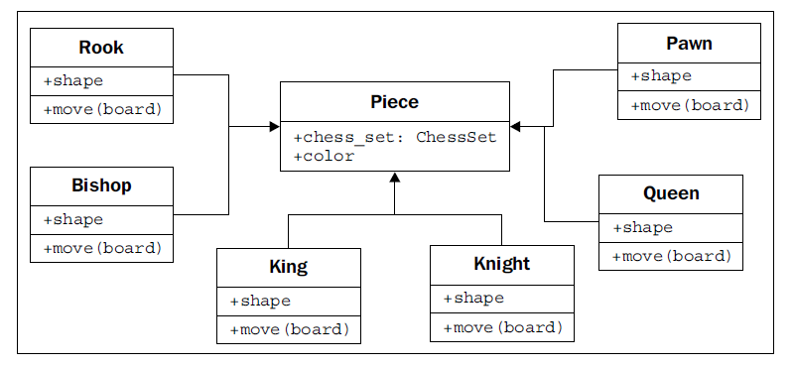
there are 32 chess pieces in our chess set, but there are only six different types of pieces (pawns, rooks, bishops, knights, king, and queen). All of these have properties, such as color and the chess set they are part of, but they also have unique shapes when drawn on the chess board, and make different moves.
Let's see how the six types of pieces can inherit from a Piece class:
All the subtypes automatically have a chess_set and color attribute inherited from the base class. Each piece provides a different shape property (to be drawn on the screen when rendering the board), and a different move method to move the piece to a new position on the board at each turn.

Slide 31
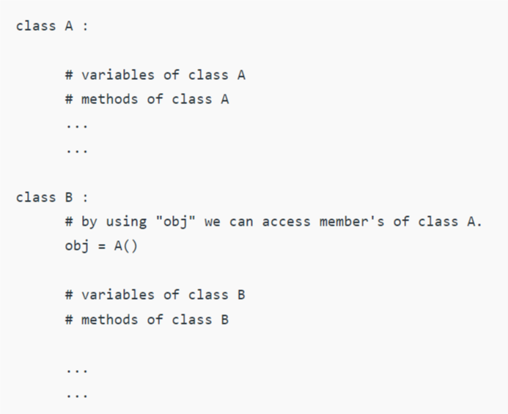
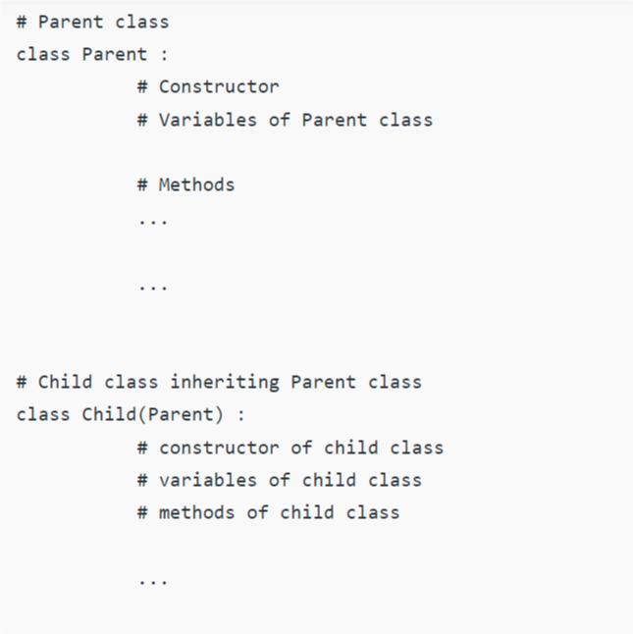
Overview of Composition vs Inheritance in Python
Composition
Inheritance

Slide 32
Basic inheritance in Python
Technically, every class we create uses inheritance! All Python classes are subclasses of the special class named object.
If we don't explicitly inherit from a different class, our classes will automatically inherit from object. However, we can openly state that our class derives from object using the following syntax:
class MySubClass(object):
pass
A superclass, or parent class, is a class that is being inherited from. A subclass is a class that is inheriting from a superclass.
A subclass is also said to be derived from its parent class or that the subclass extends the parent.

Slide 33
How do we apply inheritance in practice?
Example: a simple contact manager that tracks the name and e-mail address of several people.
class Contact:
all_contacts = []
def __init__(self, name, email):
self.name = name
self.email = email
Contact.all_contacts.append(self)
class variables:
part of the class definition, is shared by all instances of this class. This means that
there is only one Contact.all_contacts list

Slide 34
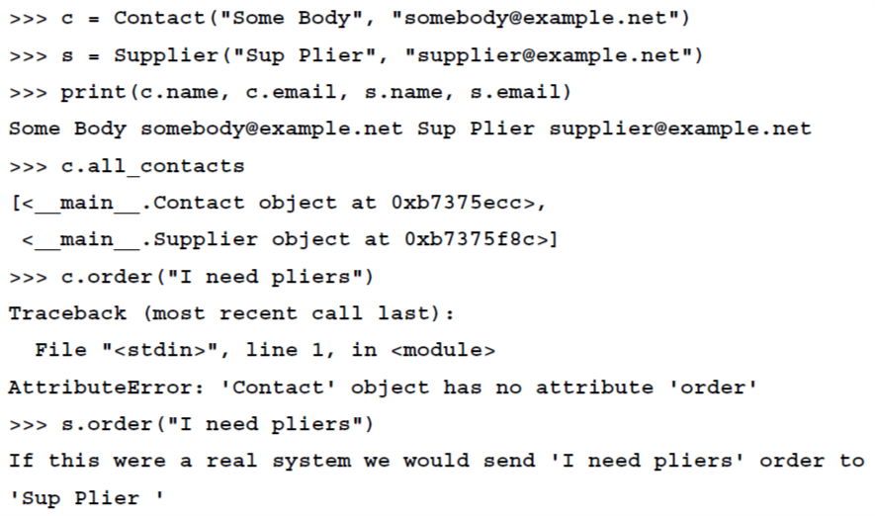
what if some of our contacts are also suppliers that we need to order supplies from?
class Supplier(Contact):
def order(self, order):
print("If this were a real system we would send "
"'{}' order to '{}'".format(order, self.name))
all contacts, including suppliers, accept a name and e-mail address in their __init__, but only suppliers have a functional order method.
our Supplier class can do everything a contact can do (including adding itself to the list of all_contacts) and all the special things it needs to handle as a supplier.

Slide 35
Extending built-ins
What if we also wanted to search list of all contacts by name?
class ContactList(list):
def search(self, name):
matching_contacts = []
for contact in self:
if name in contact.name:
matching_contacts.append(contact)
return matching_contacts
class Contact:
all_contacts = ContactList()
def __init__(self, name, email):
self.name = name
self.email = email
self.all_contacts.append(self)

Slide 36
Overriding and super
inheritance is great for adding new behavior to existing classes, but what about changing behavior ?
Overriding means altering or replacing a method of the superclass with a new method (with the same name) in the subclass. No special syntax is needed to do this; the subclass's newly created method is automatically called instead of the superclass's method.

Slide 37
Example for overriding
Our contact class allows only a name and an e-mail address. This may be sufficient for most contacts, but what if we want to add a phone number for our close friends?
class Friend(Contact):
def __init__(self, name, email, phone):
self.name = name
self.email = email
self.phone = phone
Issues?
duplicate code to set up the name and email properties
Friend class is neglecting to add itself to the all_contacts list we have created on the Contact class
Solution:
class Friend(Contact):
def __init__(self, name, email, phone):
super().__init__(name, email)
self.phone = phone
the super function returns the object as an instance of the parent class

Slide 38
Magic (dunder) methods
What are magic methods?
some important magic methods
Magic methods in Python are the special methods that start and end with the double underscores.
Magic methods are not meant to be invoked directly by you, but the invocation happens internally from the class on a certain action.
For example, when you add two numbers using the + operator, internally, the __add__() method will be called.
To get list of magic methods from a class:
dir(class_name)
Example: dir(int)
__new__() method
is implicitly called before the __init__() method. The __new__() method returns a new object, which is then initialized by __init__().
__str__() method
returns a printable string representation of any user defined class.
__add__() method
Is invoked by + operator
__ge__() method
Is invoked by >= operator

Slide 39
Example
Override __str__() Method
Complex class
class myclass:
def __init__(self):
self.name=“Ali"
self.age=20
def __str__(self):
return "name : {} age : {}".format(self.name, self.age)
obj=myclass()
print(obj)
class Complex:
def __init__(self, re=0, im=0):
self.re = re
self.im = im
def __add__(self, other):
if isinstance(other, int) or isinstance(other, float):
return Complex(self.re + other,self.im)
elif isinstance(other, Complex):
return Complex(self.re + other.re , self.im + other.im)
else:
raise TypeError
a =Complex(3,4)
b = Complex(5,6)
c = a+b

Slide 40
Example
Check Vector3d notebook for a more complex example

Slide 41
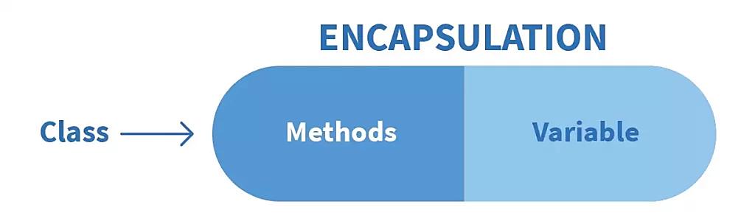
Encapsulation
What?
Example
The basic idea of Encapsulation is to wrap up both data and methods into one single unit
Encapsulation provides well-defined, readable code
Prevents Accidental Modification or Deletion
Encapsulation provides security
It can prevent outer classes from accessing and changing attributes and methods of a class. This also helps to achieve data hiding.

Slide 42
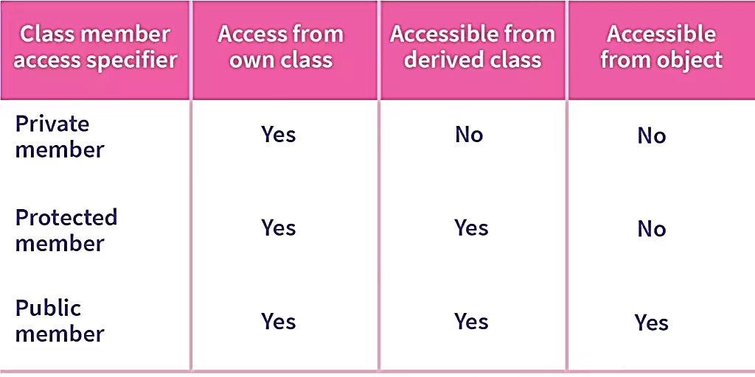
Access Modifiers in Python encapsulation
Public Members
Private Members
Protected Members

Slide 43
Encapsulation in Python using public members
the public modifier allows variables and functions to be accessible from anywhere within the class and from any part of the program.
All member variables have the access modifier as public by default.
class Rectangle:
def __init__(self):
self.length = 5
self.width = 3
rect = Rectangle()
print(rect.length)
print(rect.width)

Slide 44
Encapsulation in Python using private members
The private access modifier allows member methods and variables to be accessed only within the class.
To specify a private access modifier for a member, we make use of the double underscore __.
Note: you can still access private members by following syntax:
object._class__attribute
Example: rect._Rectangle__width
class Rectangle:
def __init__(self):
self.__length = 5
self.__width = 3
rect = Rectangle()
print(rect.length)
print(rect.width)
We will get AttributeError!

Slide 45
Encapsulation in Python using protected members
What sets protected members apart from private members is that they allow the members to be accessed within the class and allow them to be accessed by the sub-classes involved.
In Python, we demonstrate a protected member by prefixing with an underscore _ before its name.
Note: protected members can be accessed from out of the class as well. This is just conventional!
class Rectangle:
def __init__(self):
self._length = 5
self._width = 3
rect = Rectangle()

Slide 46
Example! What is the output of the following code?
class Computer:
def __init__(self):
self.__maxprice = 900
def sell(self):
print("Selling Price: {}".format(self.__maxprice))
def setMaxPrice(self, price):
self.__maxprice = price
c = Computer()
c.sell()
c.__maxprice = 1000
c.sell()
c.setMaxPrice(1000)
c.sell()
We achieved data hiding & prevention from accidental modifications!
We used a “setter function” to be able to change it.

Slide 47

Abstraction
What?
Example
Abstraction in python is defined as a process of handling complexity by showing only necessary implementation and hiding unnecessary details from user.

Slide 48
Abstract classes: One way to achieve generalization & abstraction
What?
Syntax
An abstract/base class can be considered as a blueprint for other classes. It allows you to create a set of methods that must be created within any child classes built from the abstract class.
A class which contains one or more abstract methods is called an abstract class.
An abstract method is a method that has a declaration but does not have an implementation.
When we want to provide a common interface for different implementations of a component, we use an abstract class
Forcing child classes to provide their own separate implementation
from abc import ABC, abstractmethod
class <Abstract_Class_Name>(ABC):
@abstractmethod
def <abstract_method_name>(self,other_parameters):
pass

Slide 49
Example
from abc import ABC, abstractmethod
class Shape(ABC):
def __init__(self, shape_name):
self.shape_name = shape_name
@abstractmethod
def draw(self):
pass
class Circle(Shape):
def __init__(self):
super().__init__("circle")
def draw(self):
print("Drawing a Circle")

Slide 50
Question time! What are the outputs of following codes?
Example 1
Example 2
shape = Shape()
Hint: We are instantiating from an abstract class
Changing the Shape abstract class as:
from abc import ABC, abstractmethod
class Shape(ABC):
def __init__(self, shape_name):
self.shape_name = shape_name
def print_greetings(self):
print("Hello from Shape class")
@abstractmethod
def draw(self):
pass
circle = Circle()
circle.print_greetings()

Slide 51
Final notes on abstract classes
We can make abstract classes in Python using abc module of Python
We can implement abstract classes by inheriting the ABC class
We use @abstractmethod decorators to define abstract methods in Python
Abstract classes help to provide the blueprint for another class
Abstract classes may contain concrete methods
Abstract classes cannot be instantiated
Abstract classes ensure that our software is flexible enough to support future changes

Slide 52

Abstraction:
Process of picking/showing the essence of an object you really need
Example:
a. TV: Sound, Visuals, Power Input, Channels Input. b. Mobile: Button/Touch screen, power button, volume button, sim port. c. Car: Steering, Break, Clutch, Accelerator, Power.
ABSTRACT everything you need and ENCAPSULATE everything you don't need
Encapsulation:
Process of hiding the details of an object you don't need
hide the properties and operations you don't need from the object but are required for the object to work properly
Example:
a. TV: Internal and connections of Speaker, Display, Power distribution b/w components, Channel mechanism. b. Mobile: How the input is parsed and processed, How pressing a button on/off or changes volumes, how sim will connect to service providers. c. Car: How turning steering turns the car, How break slow or stops the car, How clutch works, How accelerator increases speed.

Slide 53
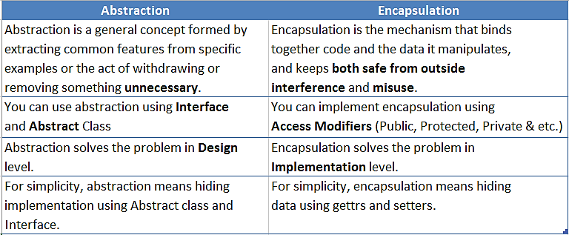
Differences between abstraction & encapsulation

Slide 54
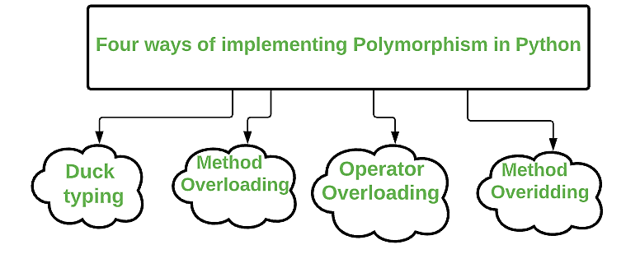
Polymorphism
The word polymorphism is taken from the Greek words poly (many) and morphism (forms).
Polymorphism in Python is the ability of an object to take many forms. Polymorphism allows us to perform the same action in many different ways.

Slide 55
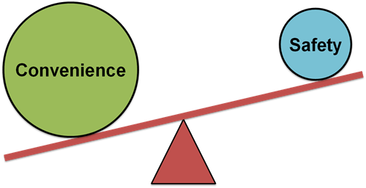
(1) Duck Typing
“If it walks like a duck, and it quacks like a duck, then it is probably be a duck.”
instead of checking the type of something in Python, check what behavior it supports
the type or the class of an object is less important than the methods it defines. Methods >>>>> type of objects

Slide 56

Examples for duck typing in python
The len method can be used with the string, list, dictionary, etc…
class Bird:
def fly(self):
print("fly with wings")
class Airplane:
def fly(self):
print("fly with fuel")
class Fish:
def swim(self):
print("fish swim in sea")
# Attributes having same name are
# considered as duck typing
for obj in Bird(), Airplane(), Fish():
obj.fly()

Slide 57
(2) Method overloading
Method overloading: Two or more methods have the same name but different numbers of parameters or different types of parameters, or both.
Python does not support method overloading by default.
But there is a way to achieve method overloading in Python.
Solution: using parameters with default values
Example:
def add(a=None, b=None):
if a != None and b == None:
print(a)
else:
print(a+b)
add(2, 3)
add(2)
def product(a, b):
p = a * b
print(p)
def product(a, b, c):
p = a * b*c
print(p)
product(4, 5)
product(4, 5, 5)

Slide 58
(3) Operator overloading
Operator Overloading means giving extended meaning beyond their predefined operational meaning.
For example operator + is used to add two integers as well as join two strings and merge two lists.
‘+’ operator is overloaded by int class and str class.

Slide 59
(4) Method overloading
method overriding occurs by defining a method in the child class with the same name as a method in the parent class.
class Parent(): def __init__(self): self.value = "Parent" def show(self): print(self.value) class Child(Parent): def __init__(self): self.value = "Child" def show(self): print(self.value) obj1 = Parent() obj2 = Child() obj1.show() obj2.show()

Slide 60
Prerequisites for learning decorators
Nested Function
We can include one function inside another, known as a nested function.
def outer(x):
def inner(y):
return x + y
return inner
add_five = outer(5)
result = add_five(6)
print(result)

Slide 61
Prerequisites for learning decorators
Pass Function as Argument
We can pass a function as an argument to another function in Python.
def add(x, y):
return x + y
def calculate(func, x, y):
return func(x, y)
result = calculate(add, 4, 6)
print(result)

Slide 62
Prerequisites for learning decorators
Return a Function as a Value
In Python, we can also return a function as a return value.
def greeting(name):
def hello():
return "Hello, " + name + "!"
return hello
greet = greeting(“Maryam")
print(greet())

Slide 63
Decorators in python
a decorator is a function that takes another function and extends the behavior of the latter function without explicitly modifying it.
def make_pretty(func):
def inner( ):
print("I got decorated")
func( )
return inner
def ordinary( ):
print("I am ordinary")
ordinary = make_pretty(ordinary)
ordinary( )
add some additional behavior to decorated function
Decorate the ordinary function
Call the decorated function

Slide 64
Decorators in python
Syntactic Sugar!
Previous way (for side by side comparison):
def make_pretty(func):
def inner( ):
print("I got decorated")
func( )
return inner
def ordinary( ):
print("I am ordinary")
ordinary = make_pretty(ordinary)
ordinary( )
def make_pretty(func):
def inner():
print("I got decorated")
func()
return inner
@make_pretty
def ordinary():
print("I am ordinary")
ordinary()

Slide 65
Decorating Functions with Parameters
def smart_divide(func):
def inner(a, b):
print("I am going to divide", a, "and", b)
if b == 0:
print("Whoops! cannot divide")
return
return func(a, b)
return inner
@smart_divide
def divide(a, b):
print(a/b)
divide(2,5)
divide(2,0)

Slide 66
Three most important fancy decorators
@property
@statismethod
@classmethod

Slide 67
@property & getter/setter
If you are an experienced coder:
Be aware:
In Python, getters and setters are not the same as those in other OOP languages.
Basically, the main purpose of using getters and setters in other OOP languages is to ensure data encapsulation.
But private variables in python are not actually hidden fields like in other object oriented languages.
Getters and Setters in python are often used when:
We use getters & setters to add validation logic around getting and setting a value.
Example for getter/setter:
class Person:
def __init__(self, age = 0):
self.__age = age
# getter method
def get_age(self):
return self.__age
# setter method
def set_age(self, x):
self.__age = x
raj = Person()
# setting the age using setter
raj.set_age(21)
# retrieving age using getter
print(raj.get_age())

Slide 68
Using @property decorators to achieve getters and setters behavior
class Person:
def __init__(self):
self.__age = 0
# using property decorator
# a getter function
@property
def age(self):
print("getter method called")
return self.__age
# a setter function
@age.setter
def age(self, a):
if(a < 0):
raise ValueError(“Sorry, age can’t be negative")
print("setter method called")
self.__age = a
mark = Person()
mark.age = 10
print(mark.age)

Slide 69
@staticmethod
Static methods in Python are extremely similar to instance methods.
The differences:
a static method is bound to a class rather than the objects for that class.
a static method can be called without an object for that class.
static methods cannot modify the state of an object as they are not bound to it.
we don’t need the self to be passed as the first argument for static methods
Syntax:
class Calculator:
@staticmethod
def addNumbers(x, y):
return x + y
print('Product:', Calculator.addNumbers(15, 110))

Slide 70
